Slide 2
Evaluating soft tissue composition of the equine palmar foot with computed tomography, magnetic resonance imaging, and 3-D image reconstruction
Adam W. Cooner*
D. Ray Wilhite, PhD
John T. Hathcock, DVM, MS, DACVR
Pete Ramey
Ivy Ramey
Debra R. Taylor, DVM, MS, DACVIM
Departments of Clinical Sciences and Anatomy, Physiology, and Pharmacology
Auburn University College of Veterinary Medicine, Auburn, AL

Slide 3
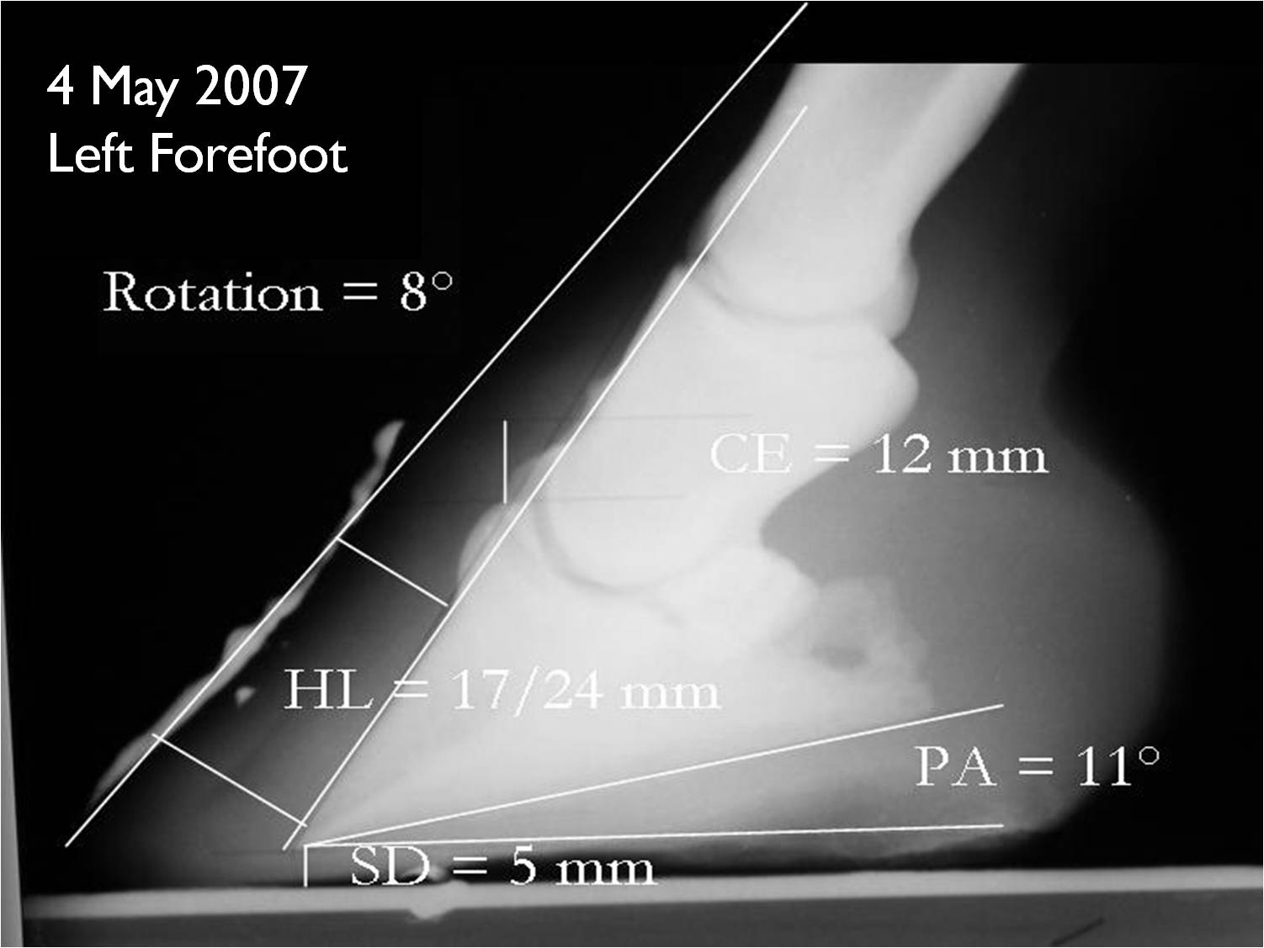
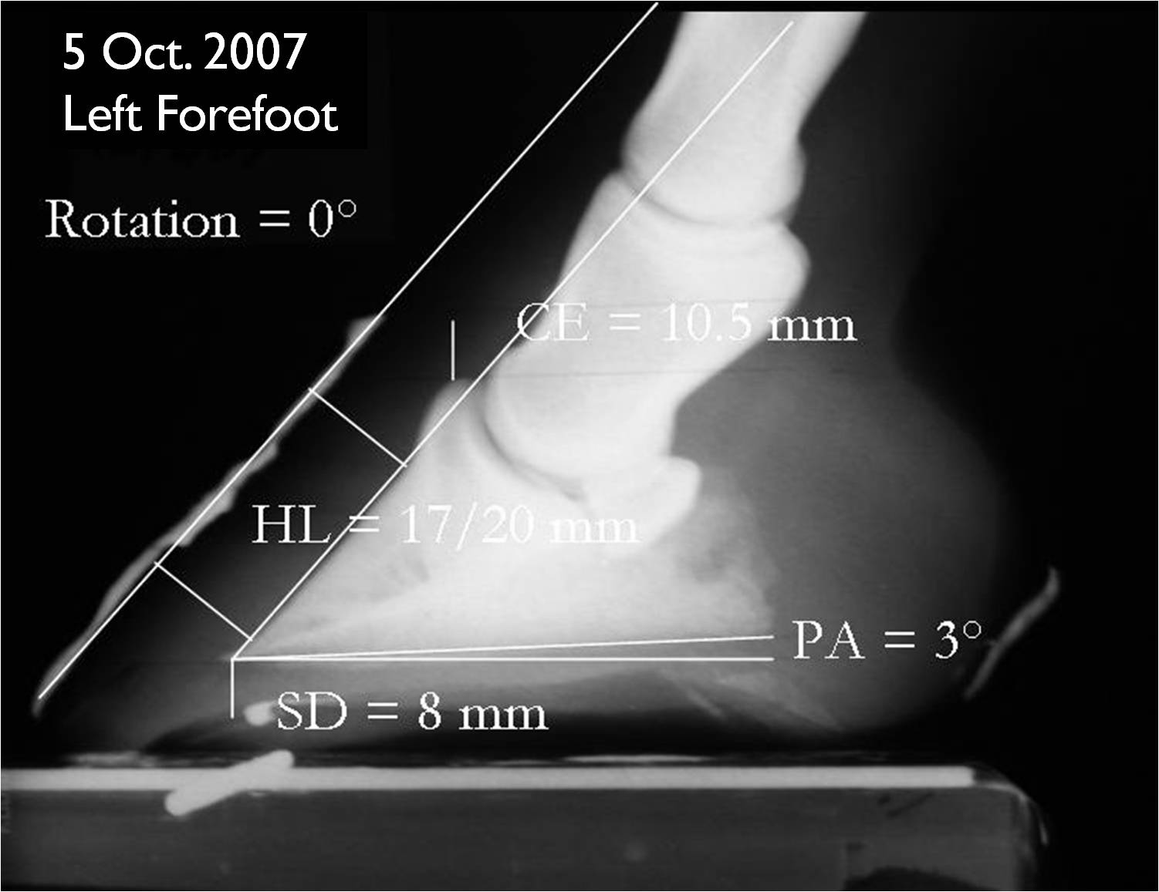
38 mm
45 mm
What accounts for the change in depth?

Slide 4
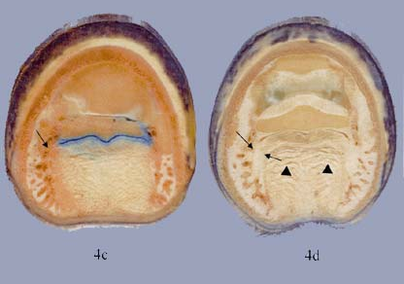
Previous studies revealed that the soft tissue composition of the equine palmar foot shows a significant degree of variation among horses (Bowker 2003).
This variability in composition is closely correlated to differences in foot health.
R.M. Bowker (2003) , www.ivis.org

Slide 5
Radiography is inadequate for evaluating soft tissues (Dyson 2003).
We hypothesized that computed tomography (CT) and magnetic resonance (MR) imaging of the equine palmar foot, combined with three-dimensional image reconstruction technology, could be used to evaluate the contrasting soft tissue compositions that exist among feet with varying degrees of development.

Slide 6
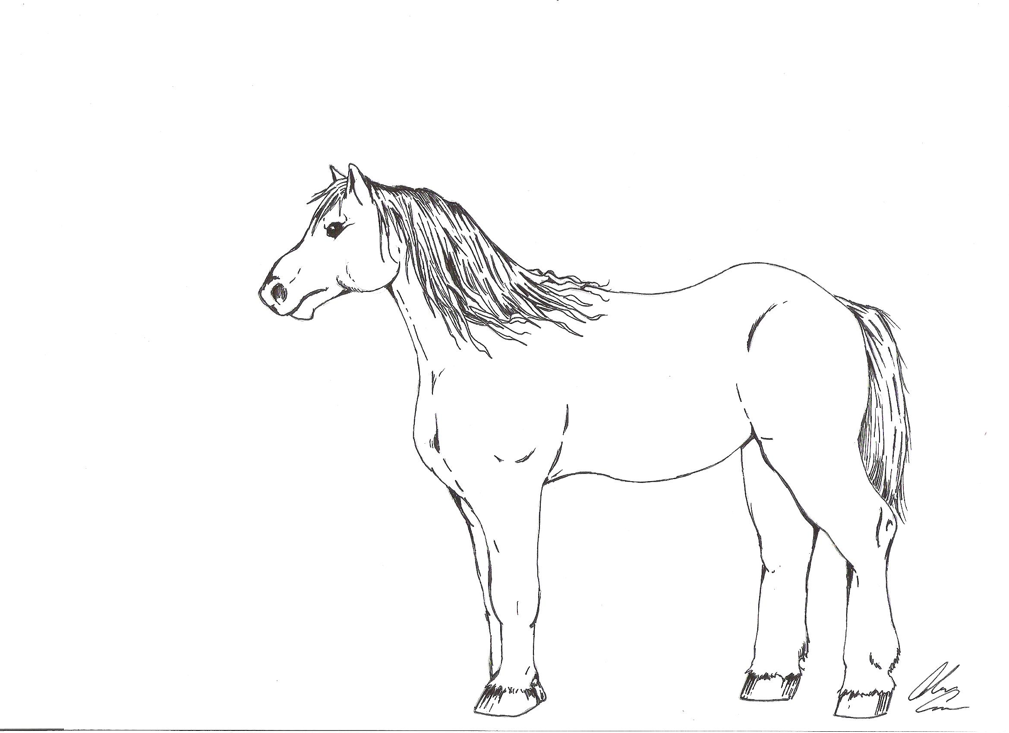
Materials and Methods

Slide 7
Choosing the Feet
We selected three cadaver forefeet from horses that had been euthanized for reasons unrelated to this study.
These included two feet in different stages of underdevelopment and one reasonably developed foot.

Slide 8
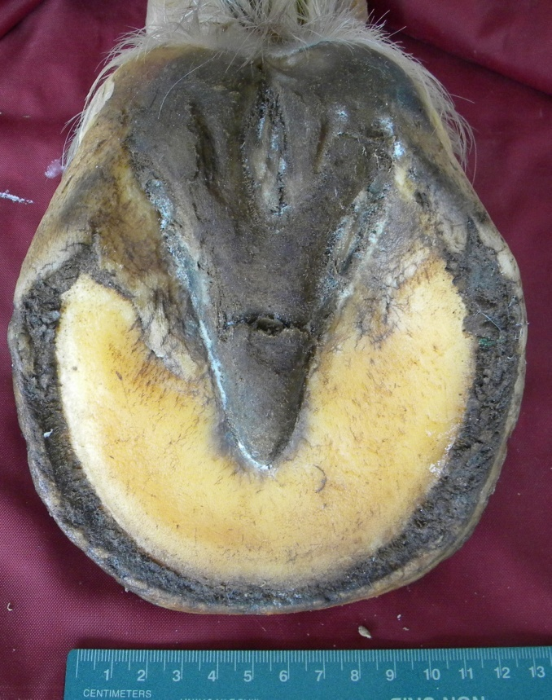
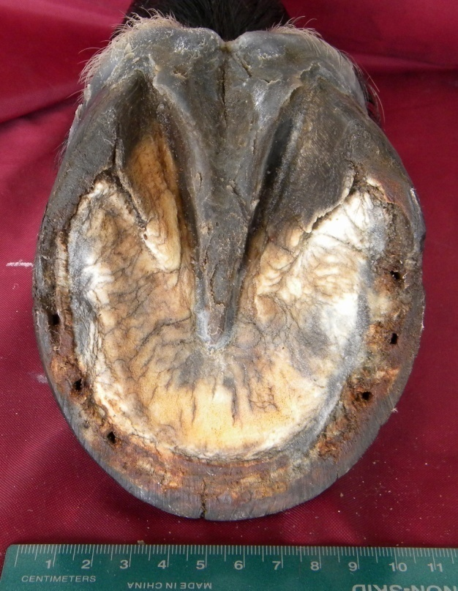
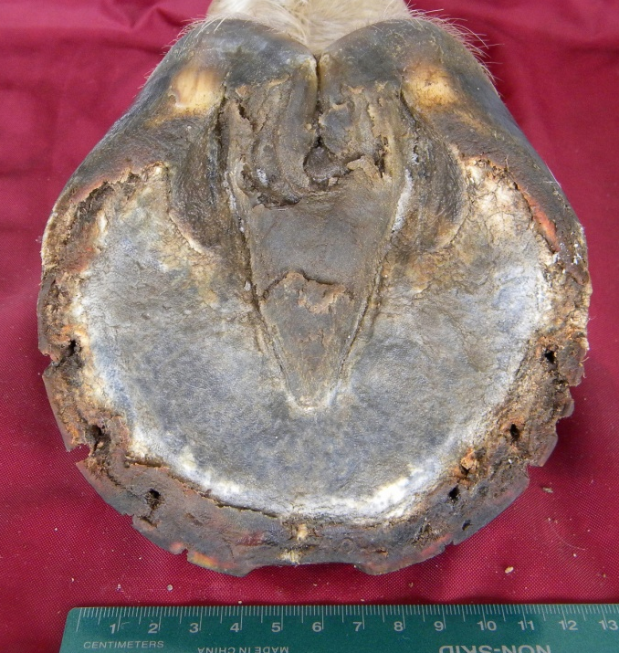
Foot 3
Foot 2
Foot 1

Slide 9
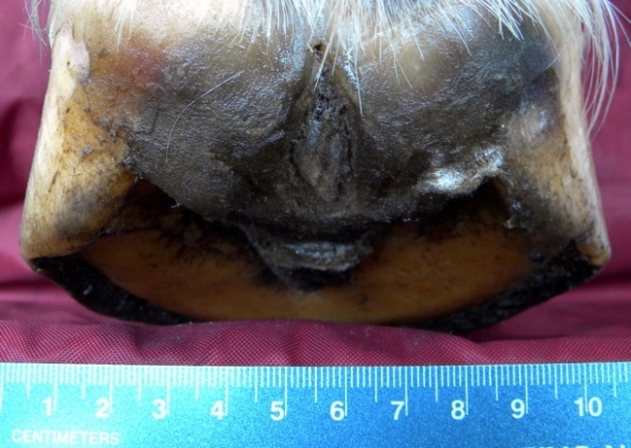
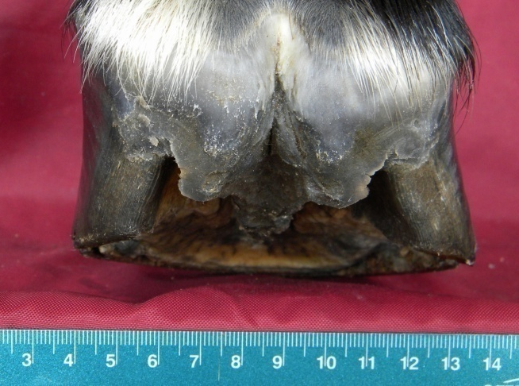
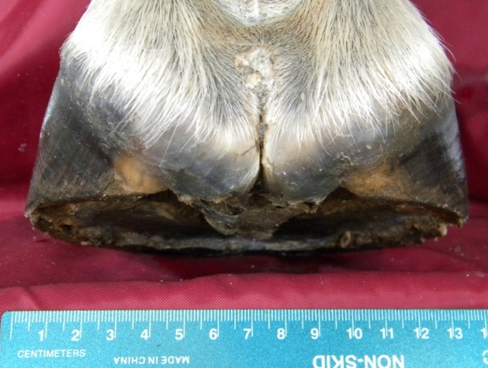
Foot 3
Foot 2
Foot 1

Slide 10
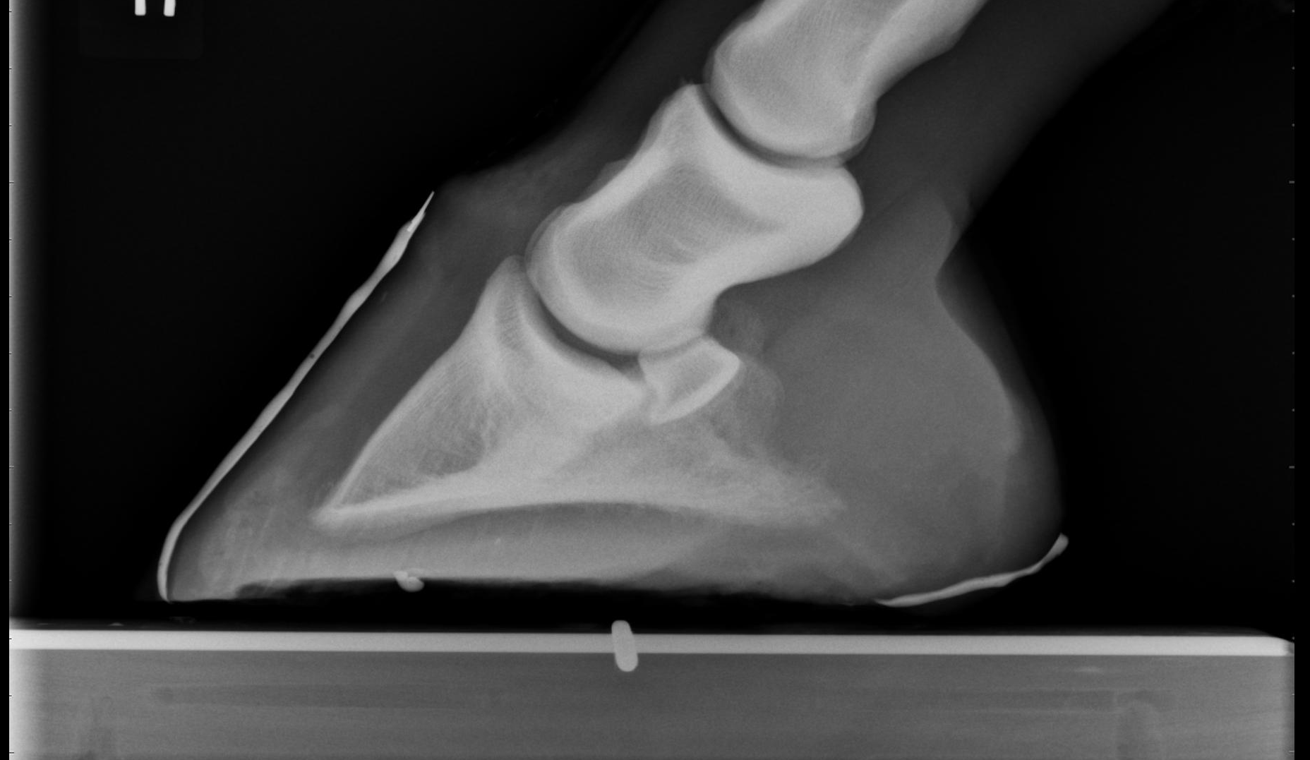
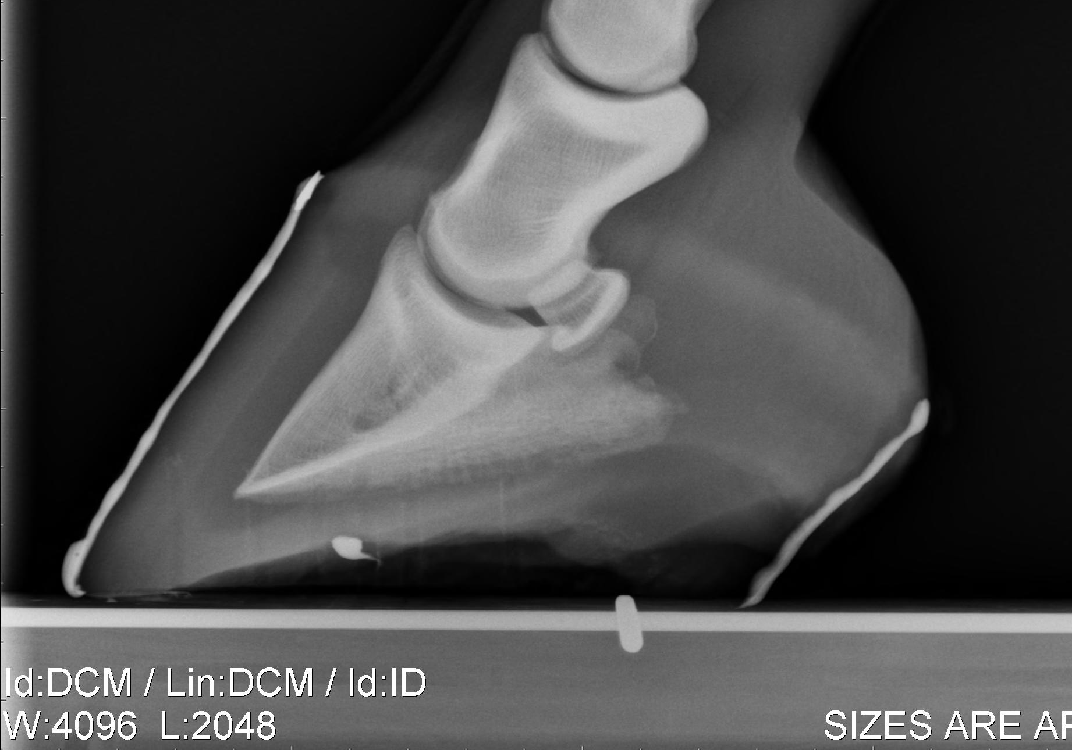
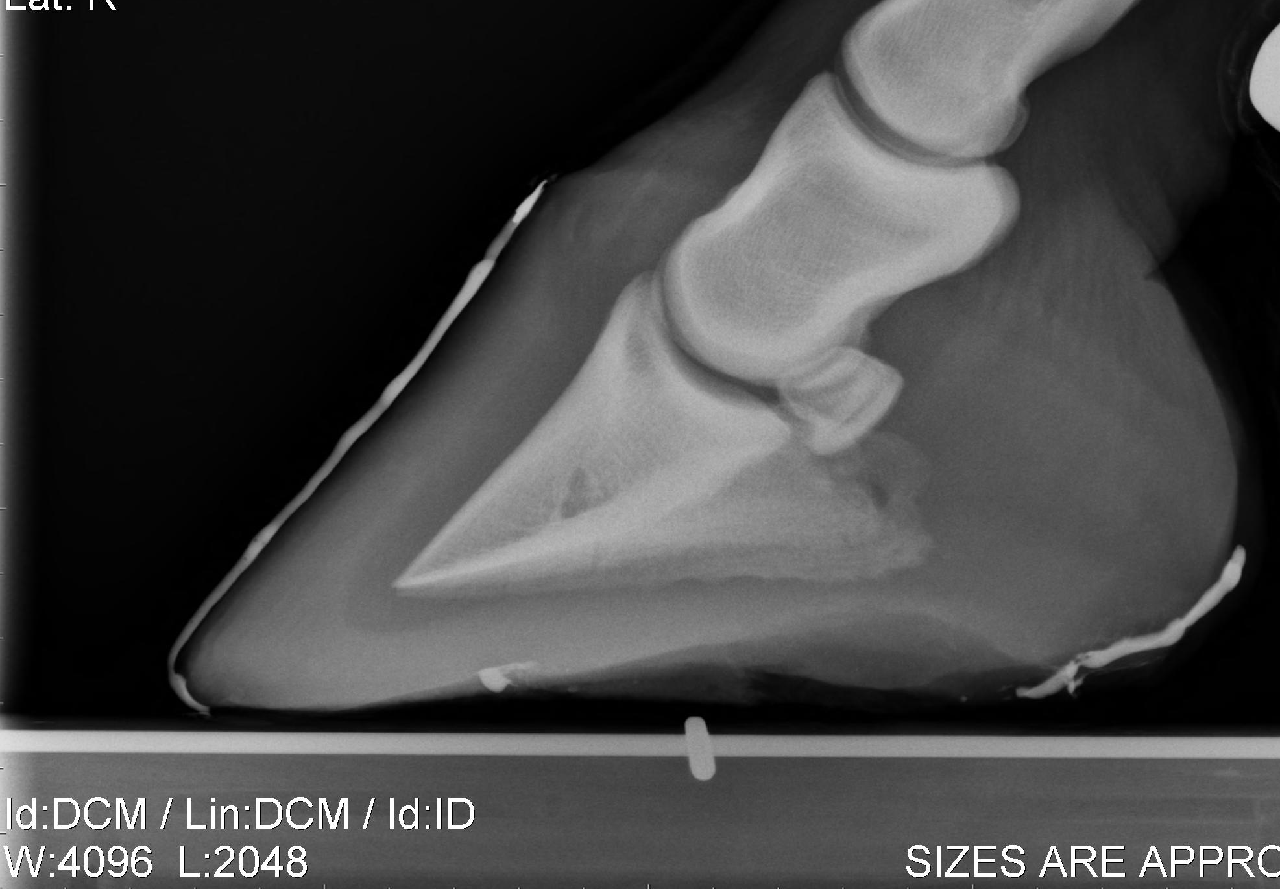
Foot 1
Lateral radiographs were made of each foot
in the AULATH (Redden 2003).
Foot 2
Foot 3

Slide 11
High-resolution CT images were obtained in a transverse plane perpendicular to the palmar angle of the distal phalanx at 1.0 mm intervals and reconstructed in Standard window with 0.5 mm overlaps.
Each foot was thawed before MR imaging (Widmer et al. 1999). MR images were obtained in the same plane with a 1.0 Tesla magnet (Kleiter et al. 1999).
Pulse sequence: Gradient Echo with Fat Saturation, Volume
Matrix: 512 x 512
Flip Angle: 30 ⁰
Signal Averages: 1
(Murray et al. 2007)

Slide 12
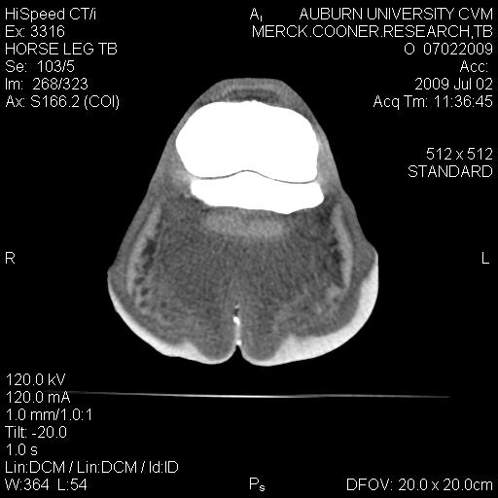
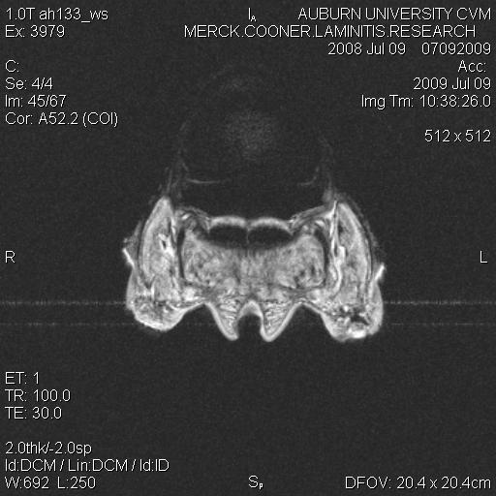
Foot 1

Slide 13
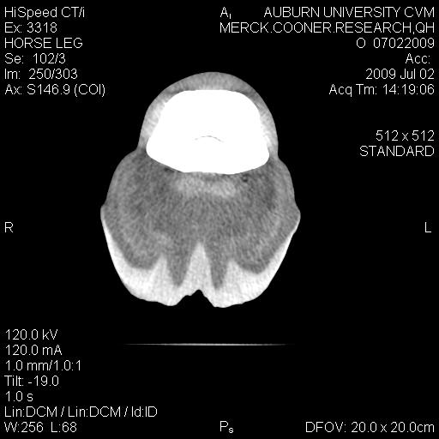
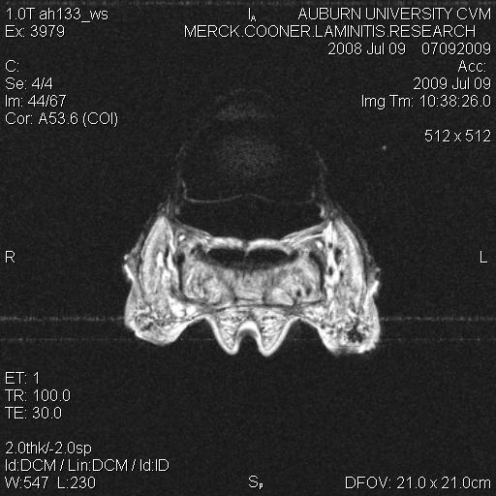
Foot 2

Slide 14
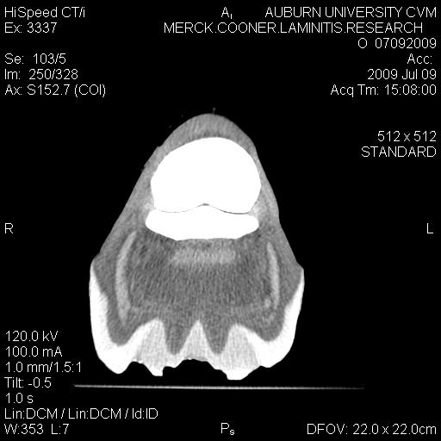
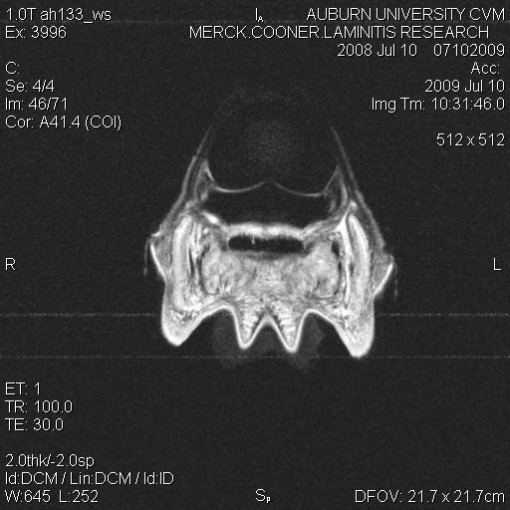
Foot 3

Slide 15
Using Mimics 13® imaging software, the collateral cartilages and digital cushion were manually isolated from each CT and MR image, respectively, to build 3-D models. The distal phalanx was isolated using the program’s bone algorithm.
For each foot, volume data was recorded from the distal phalanx, collateral cartilage, digital cushion, and digital cushion fibrocartilage models.
These models were then imported to Autodesk 3ds Max 9 Sp2® for rendering. The CT and MR data for each foot was merged by aligning the foramen of the palmar processes.

Slide 16
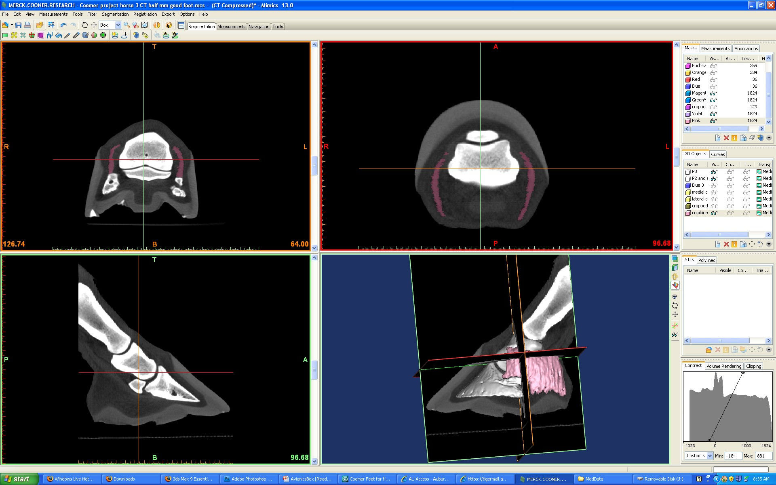
Isolating the Collateral Cartilages

Slide 17
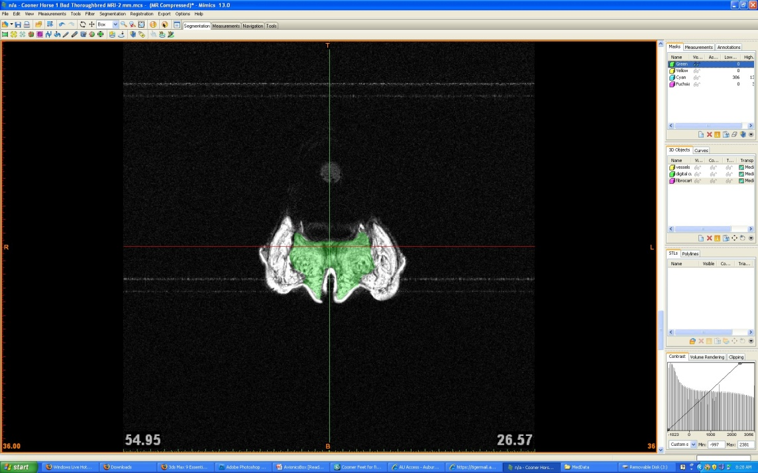
Isolating the Digital Cushion

Slide 18
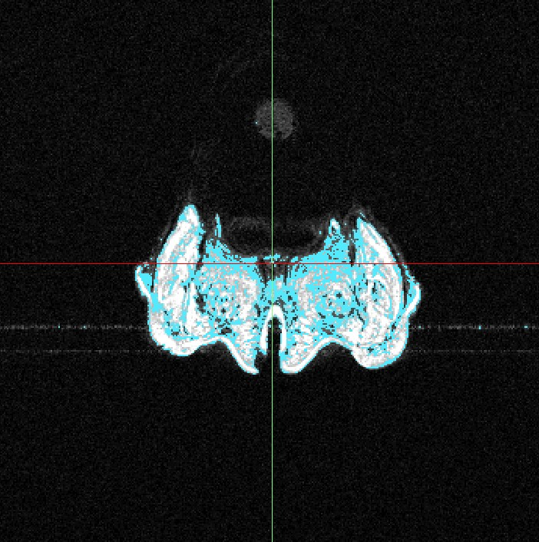
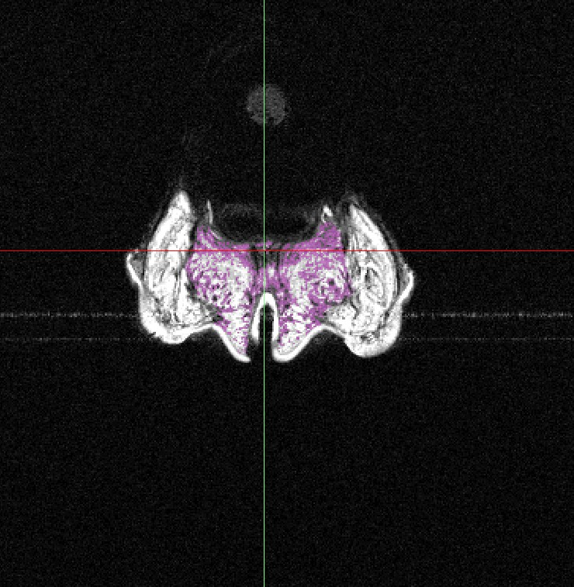
Isolating the Digital Cushion’s Fibrocartilage
A rough estimate of the digital cushion’s fibrocartilage content was made by intersecting a mask approximating fibrocartilage’s gray scale value with the digital cushion mask.

Slide 19
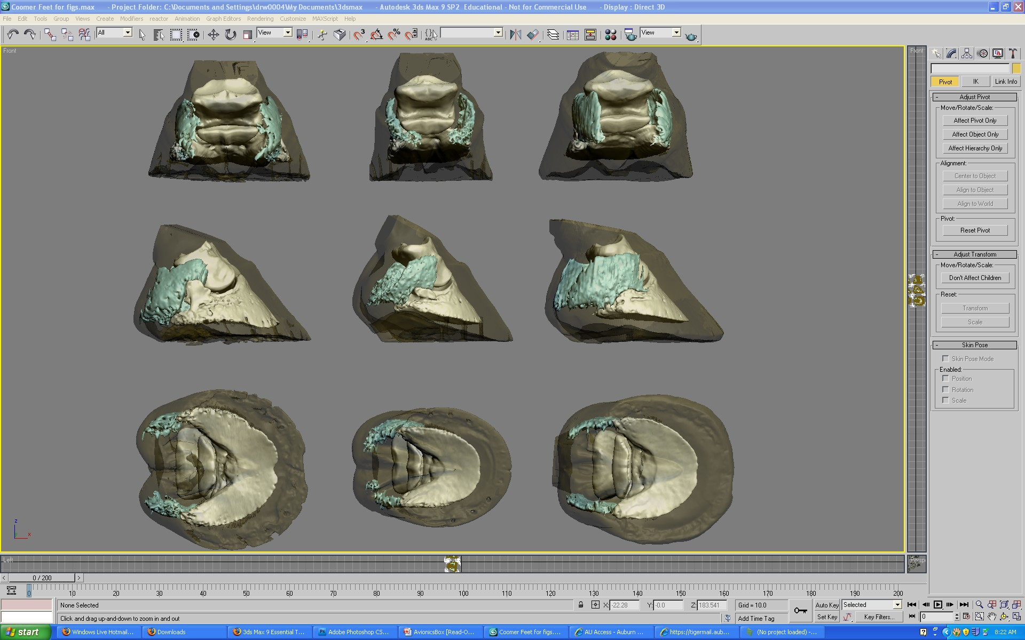
Rendering in Autodesk 3ds Max 9 Sp2

Slide 20
Results

Slide 21
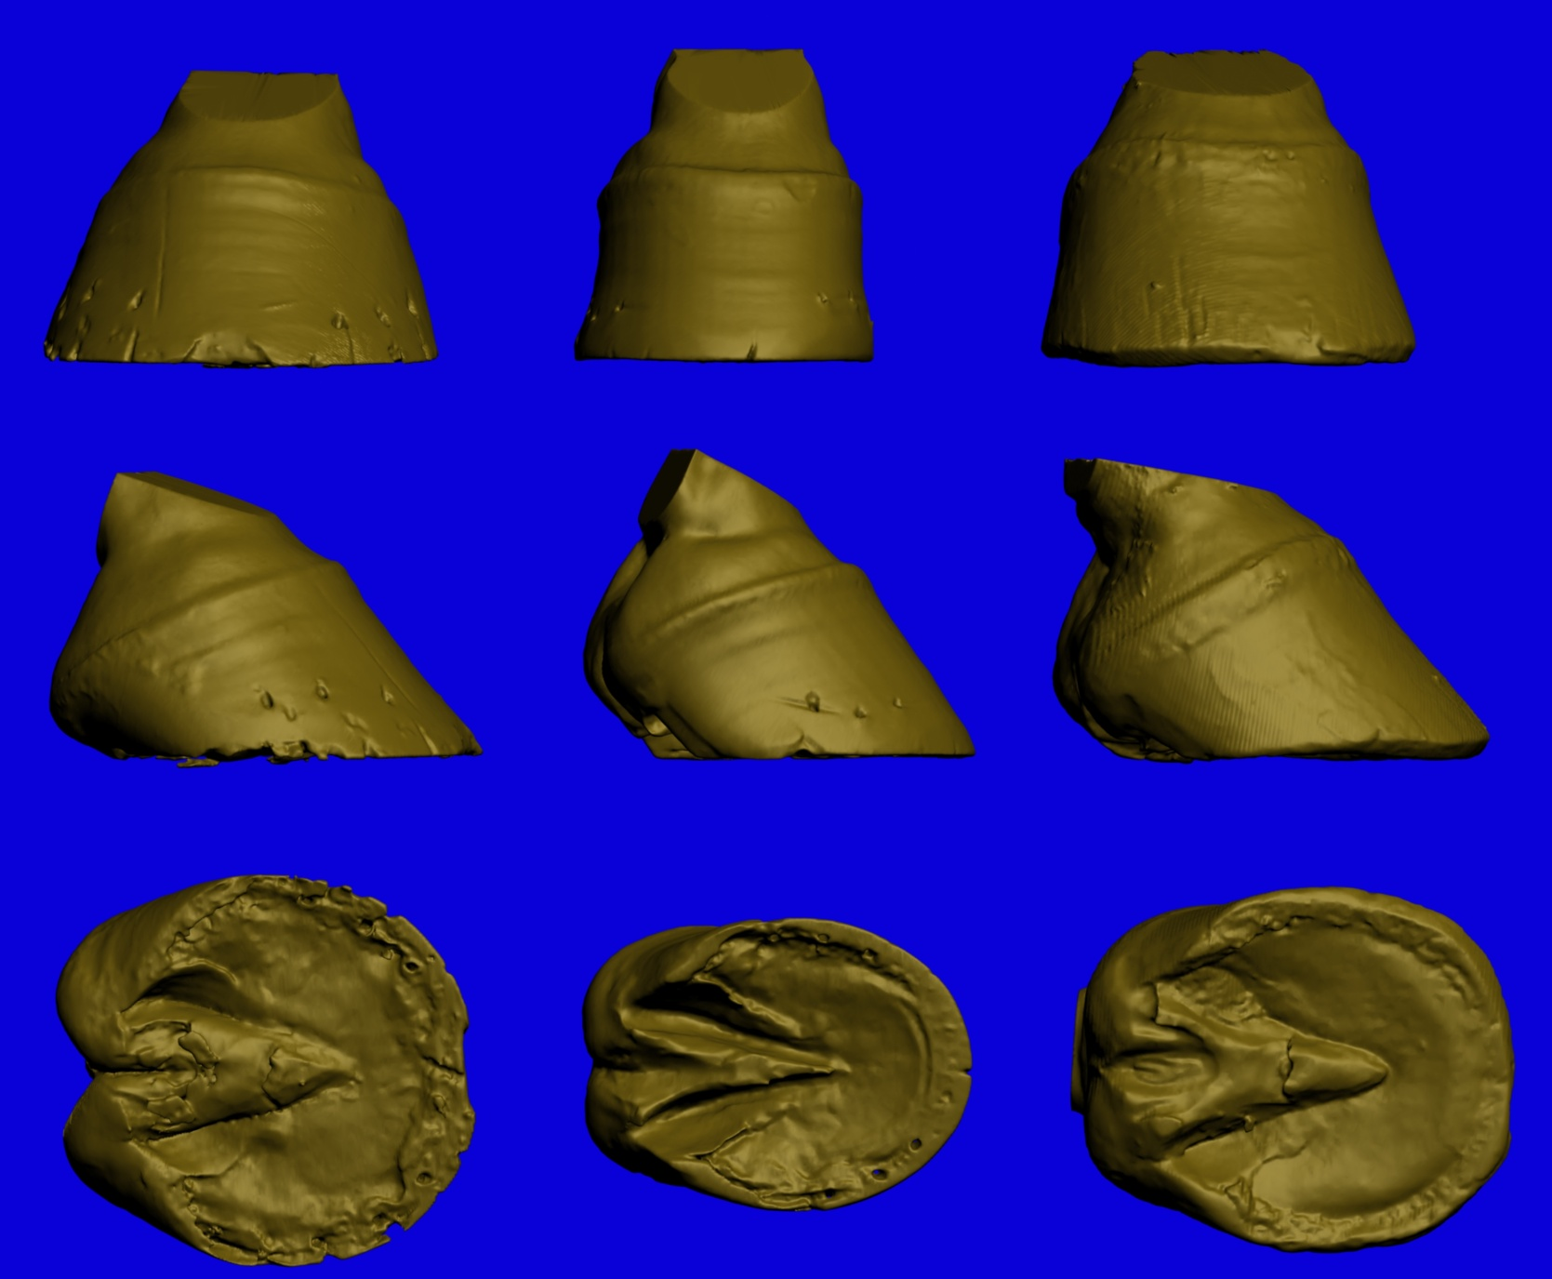
Foot 1
Foot 2
Foot 3

Slide 22

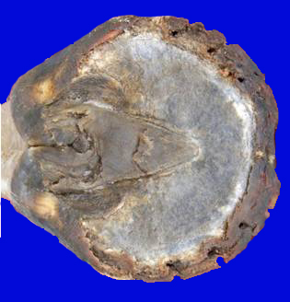
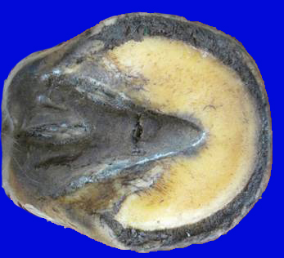
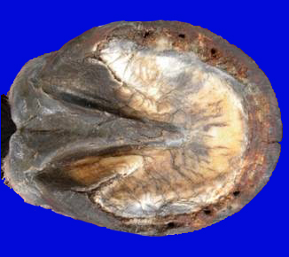

Slide 23
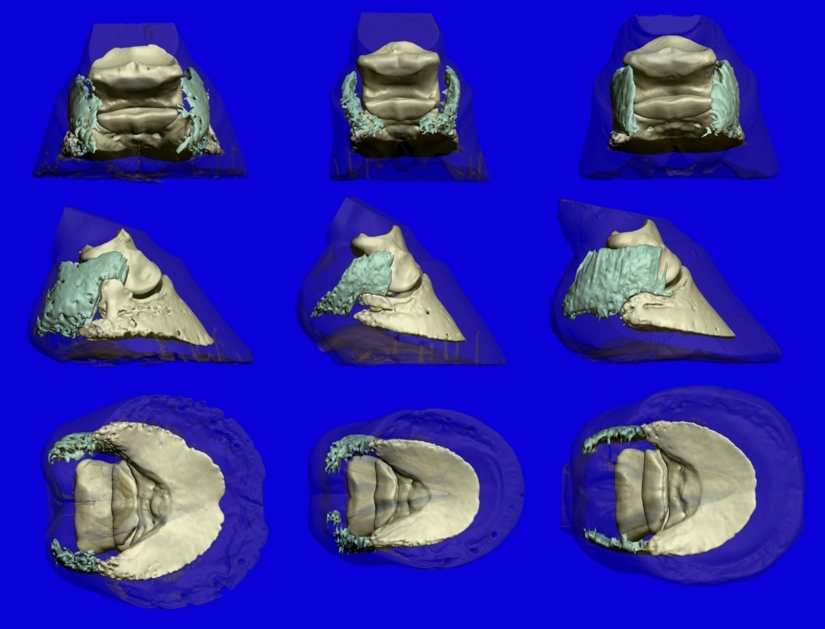
Foot 1
Foot 2
Foot 3

Slide 24
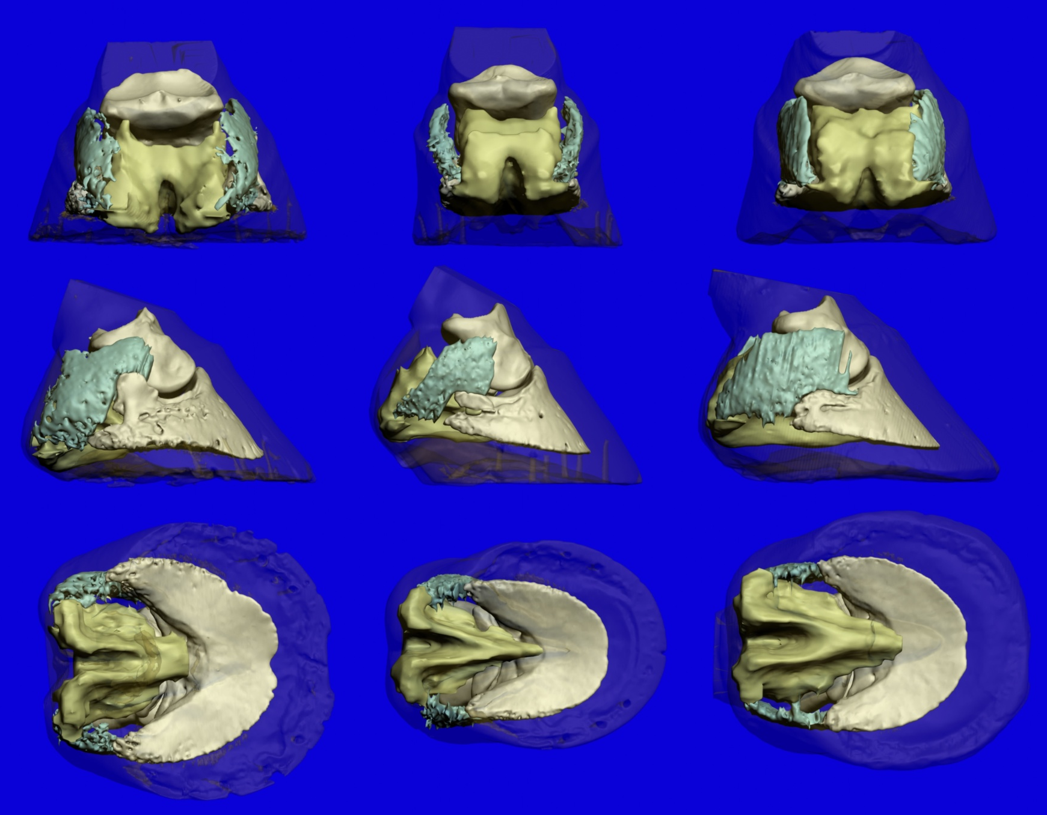
Foot 1
Foot 2
Foot 3

Slide 25
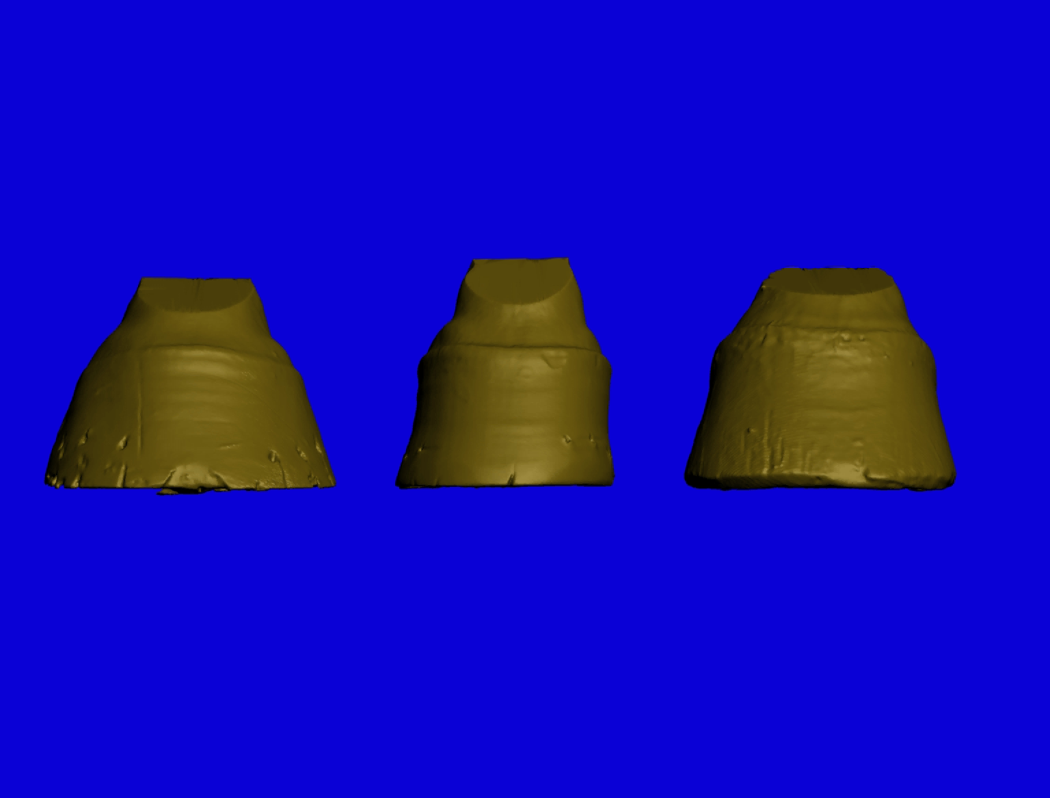

Slide 26
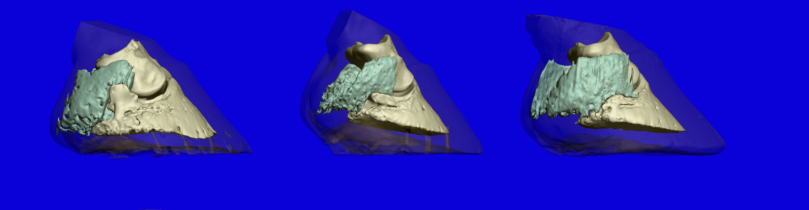
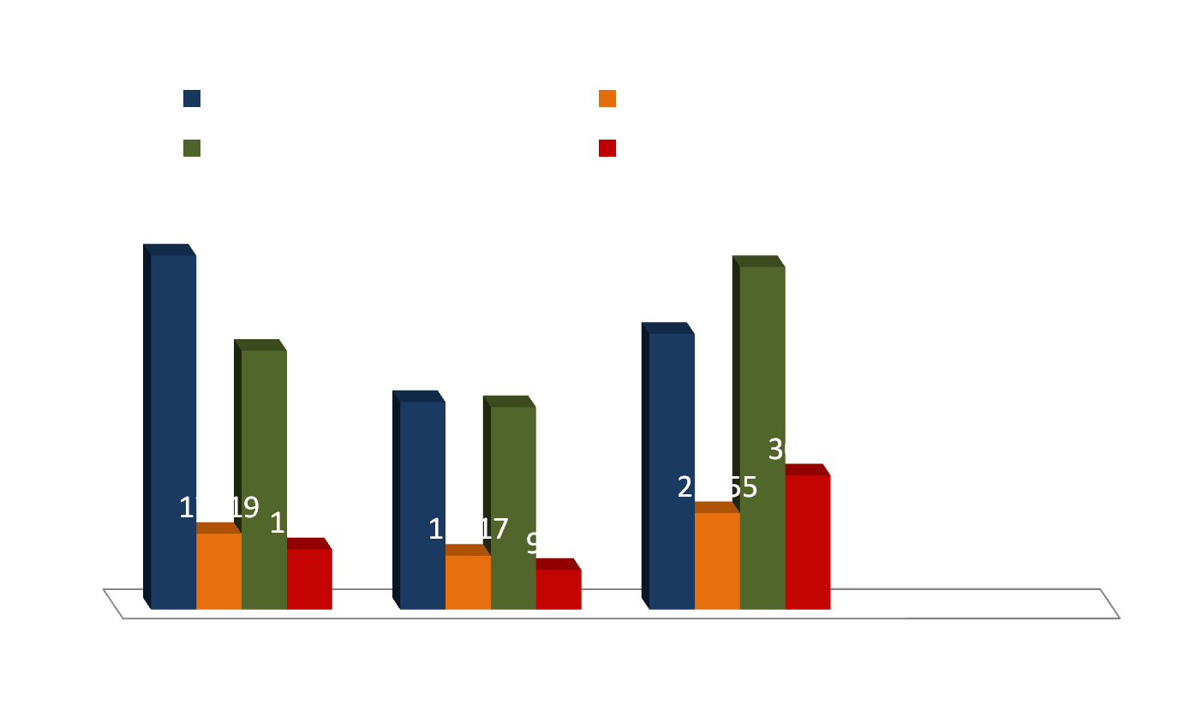

Slide 27
Volumes as Percentages of Distal Phalanx Volume
Foot 1 Foot 2 Foot 3
Collateral Cartilages (CC) 21.4 % 25.9 % 35.0 %
Digital Cushion (DC) 73.1 % 97.5 % 124 %
CC + DC 94.5 % 123 % 159 %

Slide 28
Discussion

Slide 29
In our study, the collateral cartilages and digital cushion contributed a large amount of volume to the foot, from 94.5 % to 159 % as much volume as the distal phalanx.
The volume ratios of the collateral cartilages and digital cushion to the distal phalanx were markedly greater in the reasonably developed foot than in either underdeveloped foot. Moreover, a greater percentage of its digital cushion seems to be composed of fibrocartilage.
In these 3 feet, the soft tissue volumes are impressive, and further study, with larger numbers of feet, is warranted to establish whether degree of development is, in fact, correlated with volume of soft tissue structures in the palmar foot.

Slide 30
A histological study is planned for these three feet.
We hope to correlate those findings with these to establish the accuracy of our virtual dissection.

Slide 31
No, we can’t claim statistical significance using only 3 feet, BUT . . .
We did develop a unique methodology for quantifying soft tissue structures in the equine palmar foot.
We have also (I hope) succeeded in piquing interest in an often-overlooked part of horse foot anatomy and physiology.

Slide 32
What did we get for all of our work? More questions!
With a larger number of cadaver feet, will we find a statistically significant correlation between observable foot health and palmar soft tissue composition?
How will this method of quantifying soft tissue structures translate to work on live horses?
Is the change in depth noted on post-treatment radiographs due to hyperplasia or hypertrophy of these soft tissue structures ?

Slide 33
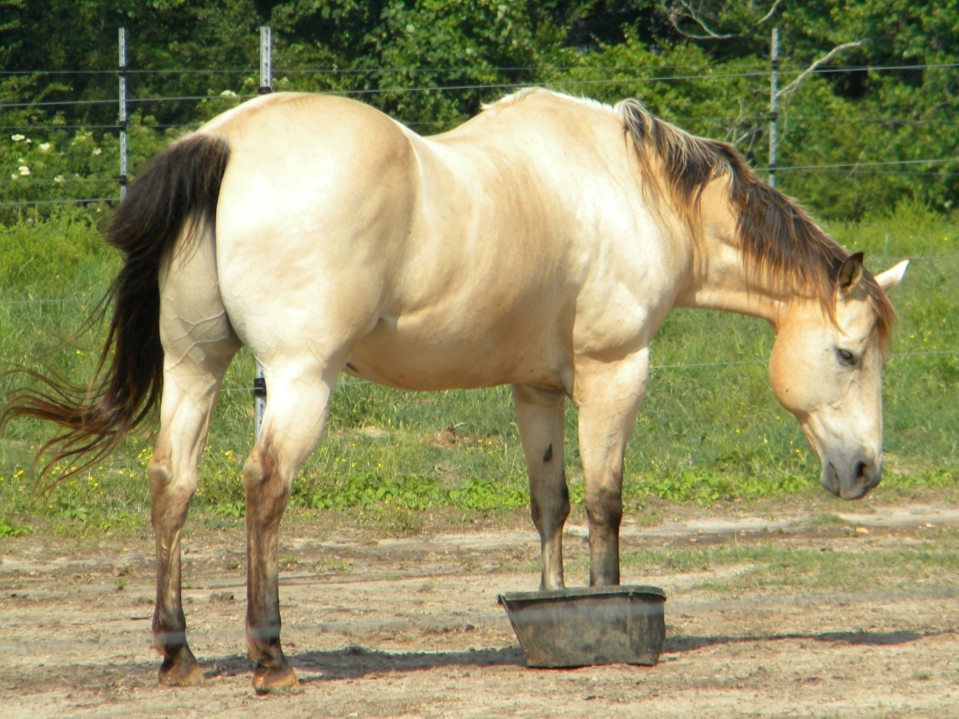

Slide 34

Acknowledgements:
Drs. Taylor, Wilhite, and Hathcock
Pete and Ivy Ramey
Ms. Kim Ward
Mr. Terrell Linch
Ms. Betty Files
Dr. Boudreaux
AUCVM
Merck-Merial
EasyCare, Inc.

Slide 35
References
Bowker RM. Contrasting structural morphologies of “good” and “bad” footed horses. In: Proceedings of the49th Annu Am Assoc Equine Pract Conv 2003; 186-209.
Dyson S, Murray R, Schramme M, Branch M. Magnetic resonance imaging of the foot: 15 horses. Equine Vet J 2003; 35 (1): 18-26.
Kleiter M, Kneissl S, Stanek CH, et al. Evaluation of magnetic resonance imaging techniques in the equine digit. Vet Radiol Ultrasoun 1999; 40 (1): 15-22.
Murray R, Dyson S, Branch M, Schramme M. Validation of Magnetic Resonance Imaging Use in Equine Limbs. Clin Tech Equine Pract 2007; 6: 26-36.
Redden RF. Clinical and radiographic examination of the equine foot. In: Proceedings of the 49th Annu Am Assoc Equine Pract Conv 2003; 169-185.
Widmer WR, Buckwalter KA, Hill MA, et al. A technique for magnetic resonance imaging of equine cadaver specimens. Vet Radiol Ultrasoun 1999; 40 (1): 10-14.

